Slide 3
MARK YOUR CALENDAR FOR IMPORTANT SUMMER DATES:
JUNE 1-8: Puerto Rico Mission Trip
JUNE 17-21: WinShape Camp
JULY 15-19: FUSION
JULY 22-26: VBS

Slide 7
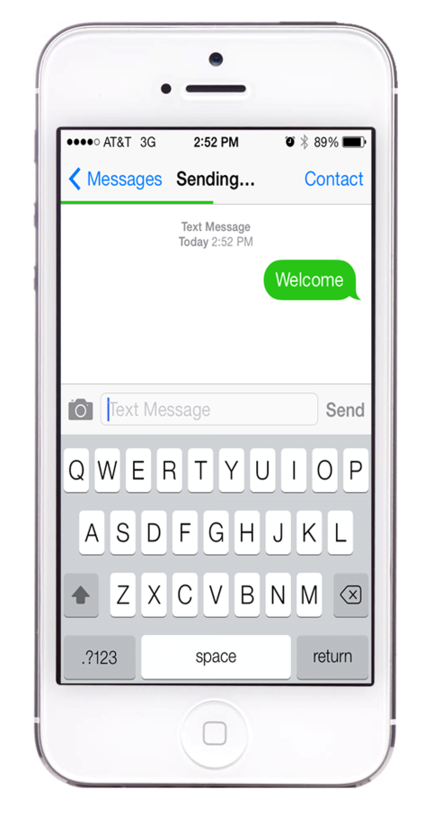
Text “Welcome” to 540-999-1889

Slide 8
*Meals Resume January 9, 2019

Slide 9
Welcome to North Roanoke and thank you for worshipping with us today! If you are a guest, we want you to feel welcome and know how grateful we are that God has sent you here. If we can serve you in any way, please don’t hesitate to ask an usher or anyone seated nearby – we are eager to help.

Slide 12
Notes:
Rotate a different cell phone slide each week

Slide 13
Notes:
Rotate a different cell phone slide each week

Slide 14
Notes:
Rotate a different cell phone slide each week

Slide 15
Notes:
Rotate a different cell phone slide each week

Slide 16
Notes:
Rotate a different cell phone slide each week

Slide 17
Notes:
Rotate a different cell phone slide each week

Slide 18
Notes:
Rotate a different cell phone slide each week

Slide 19
Notes:
Rotate a different cell phone slide each week

Slide 20
Notes:
Rotate a different cell phone slide each week

Slide 21
Notes:
Rotate a different cell phone slide each week

Slide 22
Notes:
Rotate a different cell phone slide each week

Slide 23
Notes:
Rotate a different cell phone slide each week

Slide 24
Notes:
Rotate a different cell phone slide each week

Slide 25
Notes:
Rotate a different cell phone slide each week

Slide 26
Notes:
Rotate a different cell phone slide each week

Slide 27
Notes:
Rotate a different cell phone slide each week

Slide 28
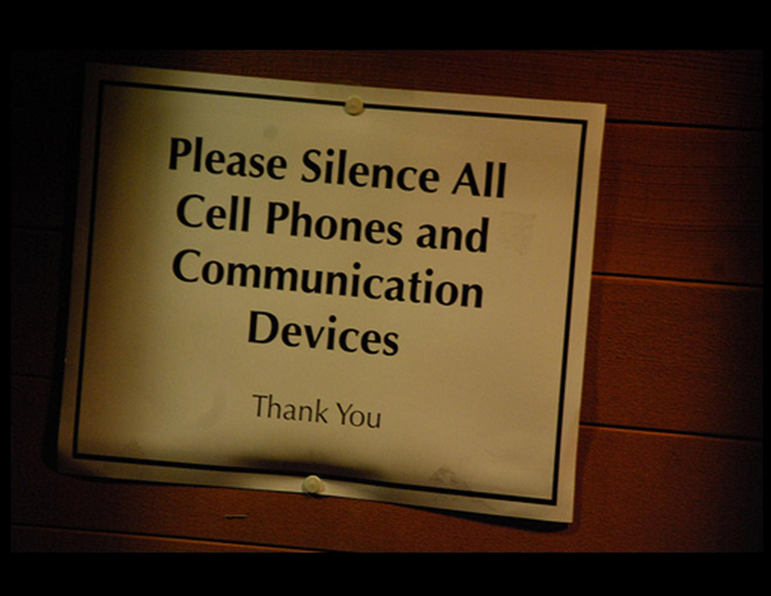
Notes:
Rotate a different cell phone slide each week

Slide 29
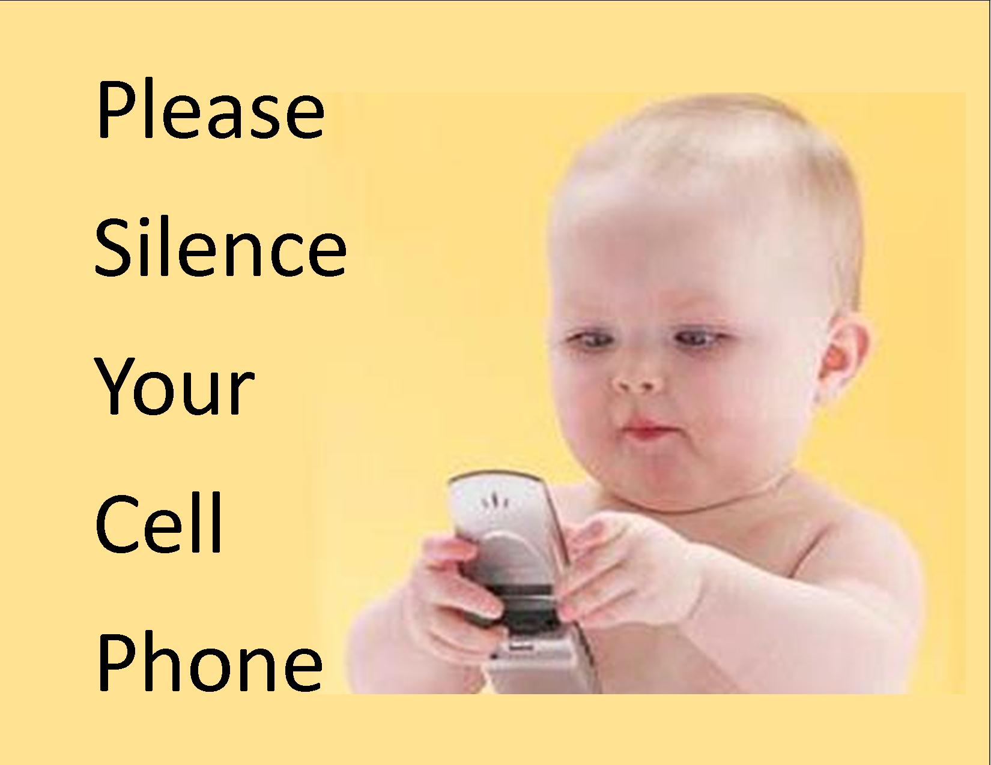
Notes:
Rotate a different cell phone slide each week

